Slide 1
EMPLOYEE ATTRITION PROJECT
USING SQL

Slide 2

INTRO:
USING DATA FROM ATLAS LABS, I HAVE PERFORMED ANALYSIS TO FIND OUT HOW DIFFERENT FACTORS AFFECT ATTRITION RATE OF A COMPANY

Slide 3
Objective:
Find out if the factors like gender, company loyalty, slow promotion, differential salary range in different departments, distance from work, etc. induce employees to quit and thus increase the attrition rate.

Slide 4
A graph of former employees showing comparison between their age and the number of years spent in the company
Age: 25-40
Years in company: 5+

Slide 5
A table showing the salary range of the three different departments and throwing light on the difference between the ones who left and the ones who remained.
Departments | Max salary | Min salary | Attrition
Sales | ₹ 3,77,203.00 | ₹ 24,583.00 | Yes
 | ₹ 4,76,951.00 | ₹ 28,024.00 | No
Tech | ₹ 1,61,600.00 | ₹ 21,350.00 | Yes
 | ₹ 5,47,204.00 | ₹ 22,162.00 | No
HR | ₹ 49,606.00 | ₹ 49,606.00 | Yes
 | ₹ 3,15,071.00 | ₹ 34,320.00 | No

Slide 6
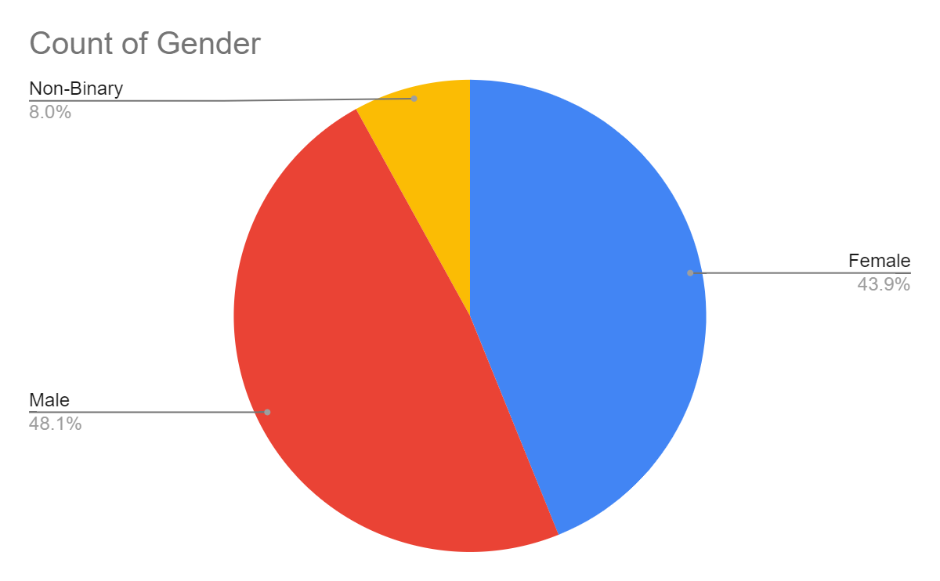
% of people who left due to slow rate of promotion shown based on gender
* More than 4 years since last promotion

Slide 7
INSIGHTS:

Slide 8
1. Age and number of years spent in the company has no such correlation to affect attrition rate.
2. Technology sector has the highest salary range
followed by Sales and HR consecutively.
There is huge difference between the salary range of
people who left and those who remained with the latter
Having much higher salary.
3. Men and Women are almost at par at leaving the company when
There is less prospect of career growth with the share of men being just 4%
more than women

Slide 9
RECOMMENDATIONS:

Slide 10
>> Attention to be paid in maintaining competitive salary structures, especially in technology and sales sector.
>> Quarterly overview of work and promotion based on that to incentivize employees.
>> There must be some interrelation existing between manager’s rating, self rating and job satisfaction levels of employees by introducing a common scale.

Slide 11
CONCLUSION:
Looking into the insights and incorporating the recommendations would result in preventing negative attrition and increase productivity.

Slide 12
Thank you!

